Slide 1
LANDLORD
A mobile game made by Group 01

Slide 2


MEMBERS
Nguyen Van Giap
Hoang Ha

Slide 3


MEMBERS
Ha Anh Tuan
Truong Quoc Tuan

Slide 4
GAME CONCEPTS
The first version of landlord

Slide 5
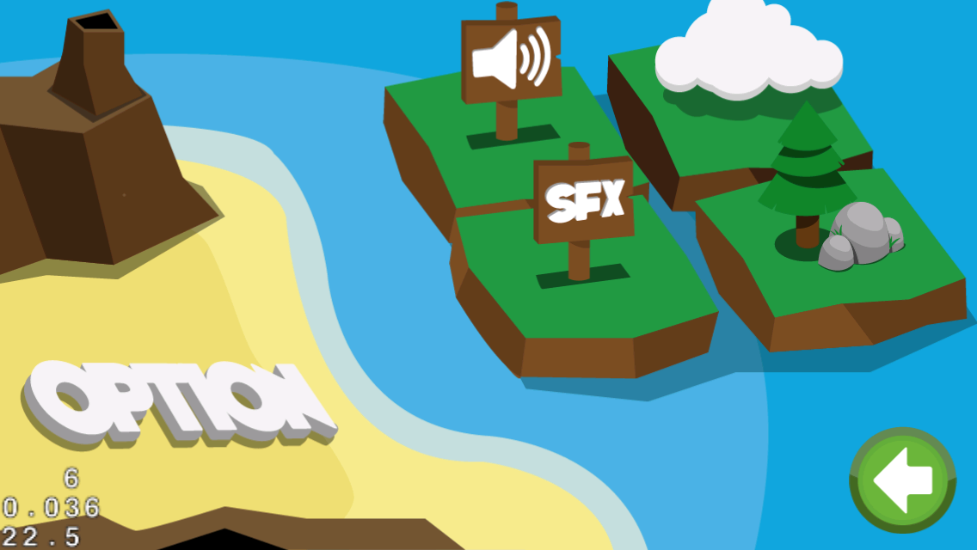
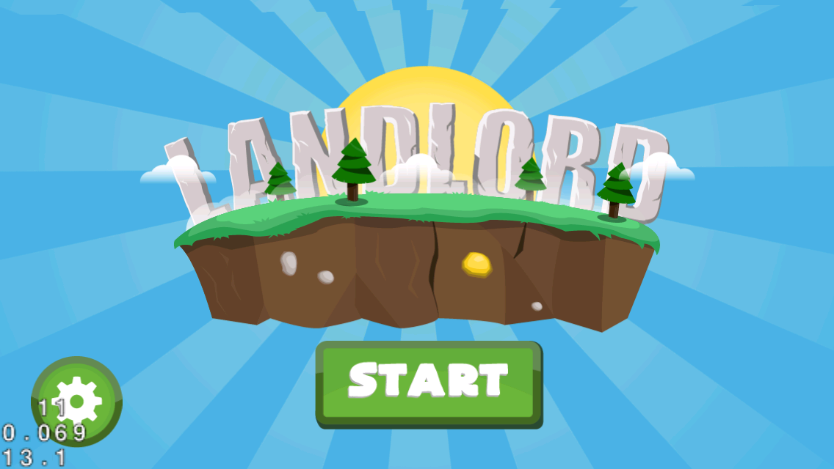

Slide 6
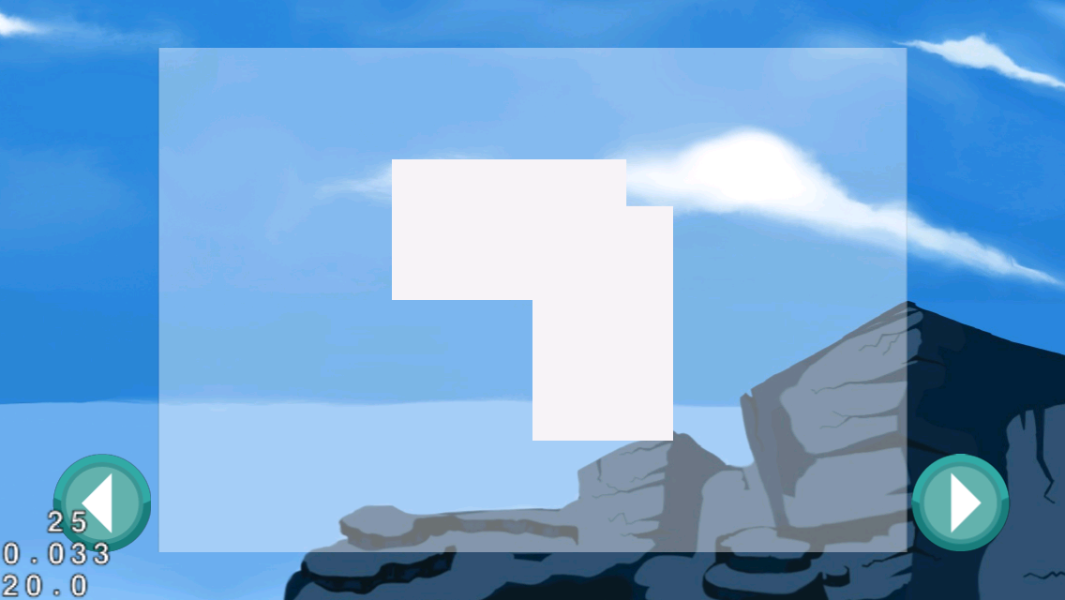
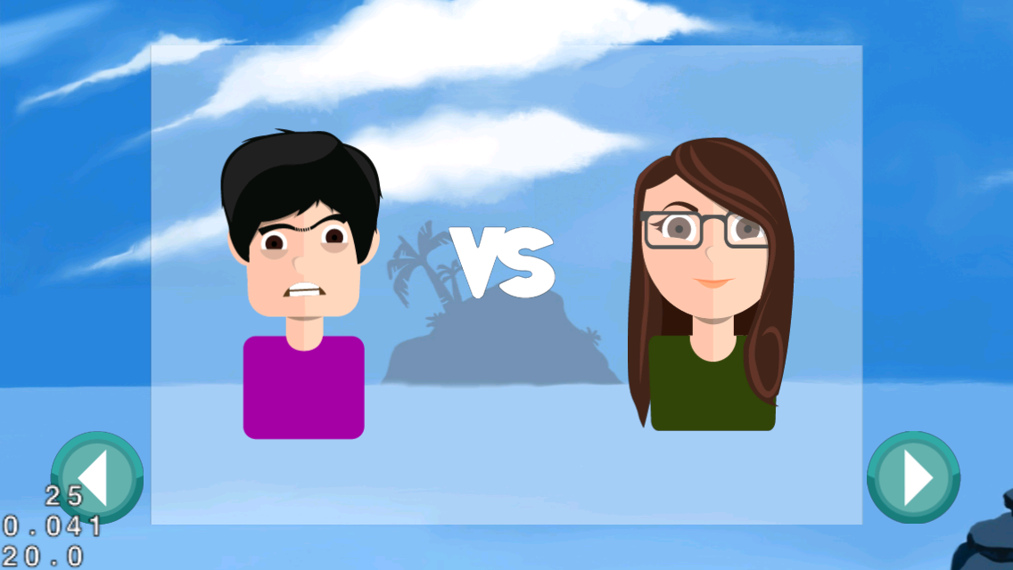

Slide 7
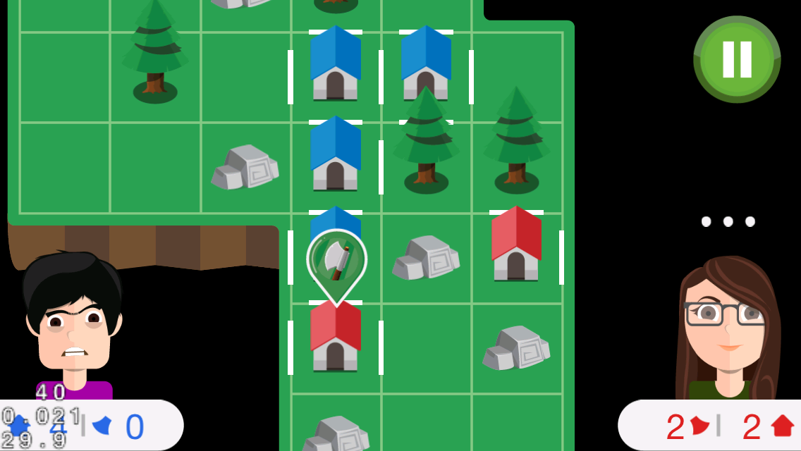
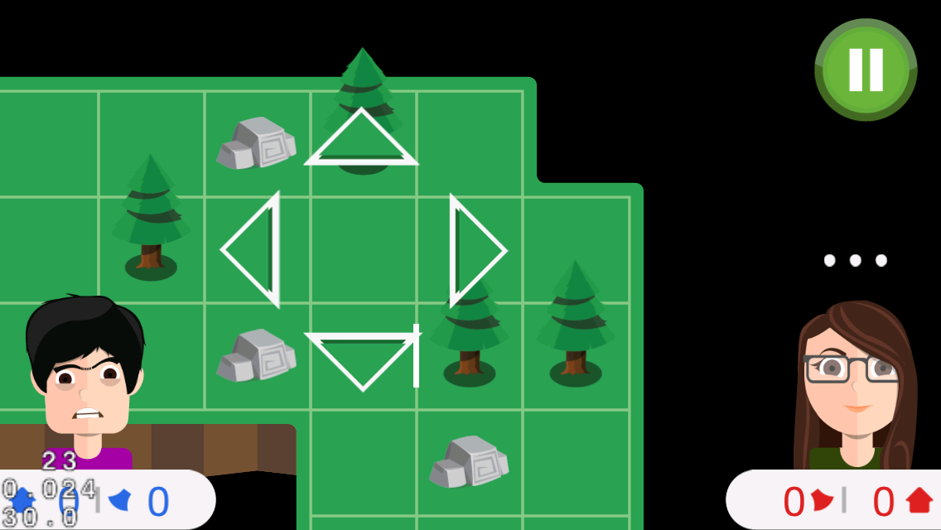

Slide 8
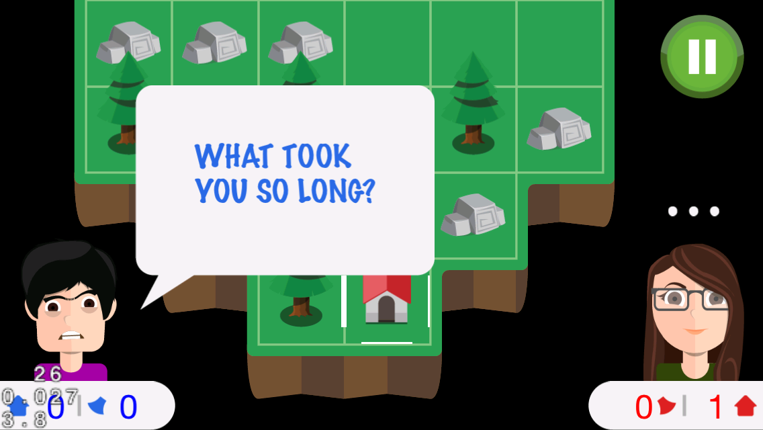
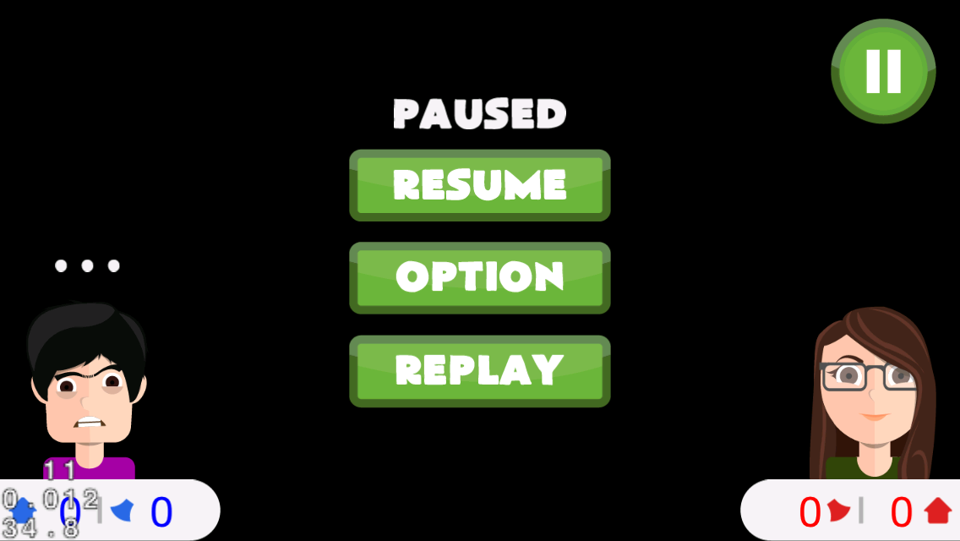

Slide 9
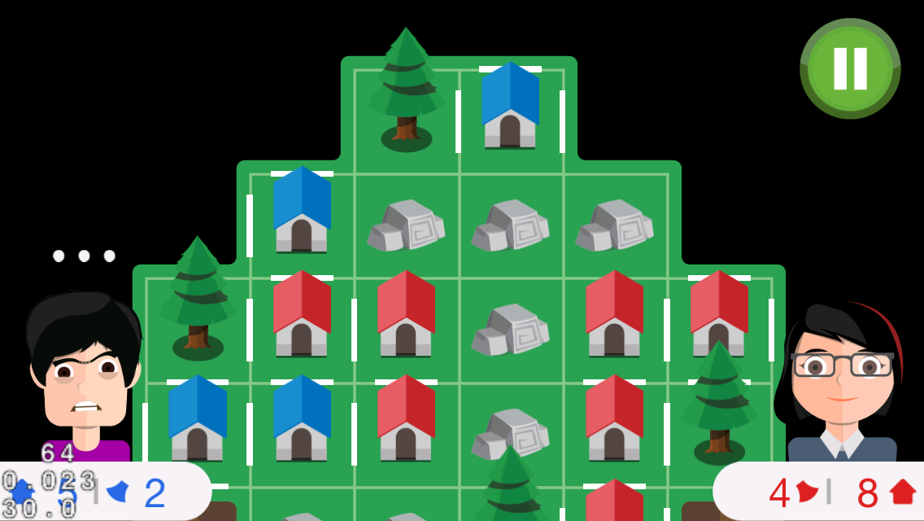


Slide 10
IDEA
inspired by a game on paper
a board game
2-player
FUN and COOL

Slide 11
GAMEPLAY
two players compete with each other
build houses and occupy the islands
tree mode, axes, …
https://github.com/tranvictor/landlord/ wiki

Slide 12
CONTROL
touch on tiles!
choose the edge to put fence
special tiles with hidden axe, tree, stone !
collect axes
use axe to cut trees

Slide 13

COCOS2D-X
An awesome framework for making cross platform mobile games

Slide 14
PROJECT MANAGEMENT
pivotaltracker.com/s/projects/1031608

Slide 15
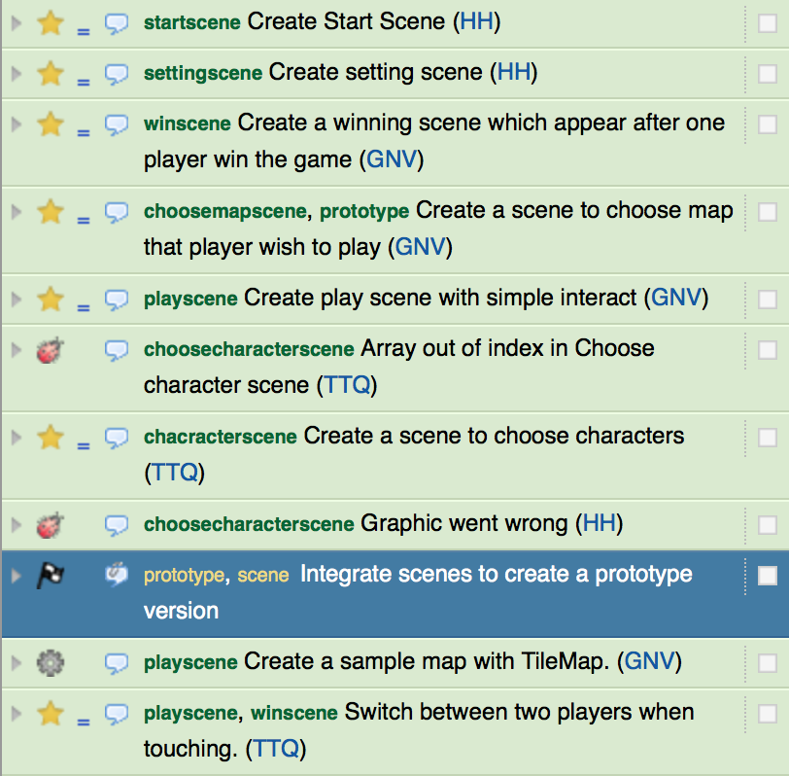
PIVOTALTRACKER

Slide 16
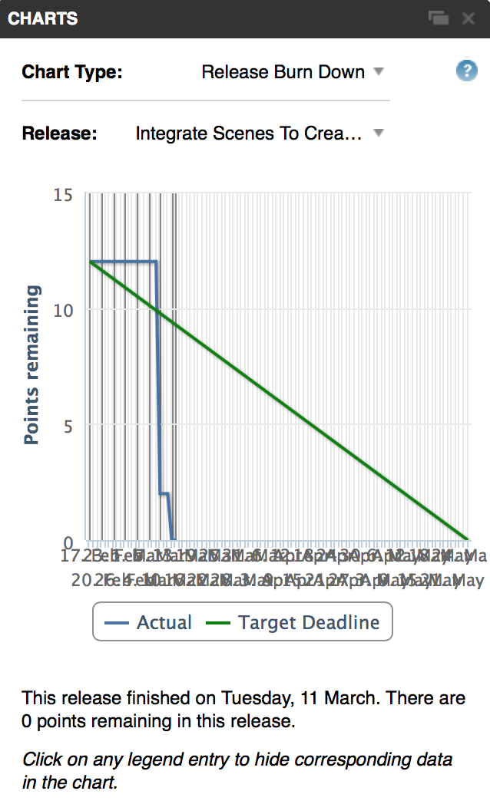
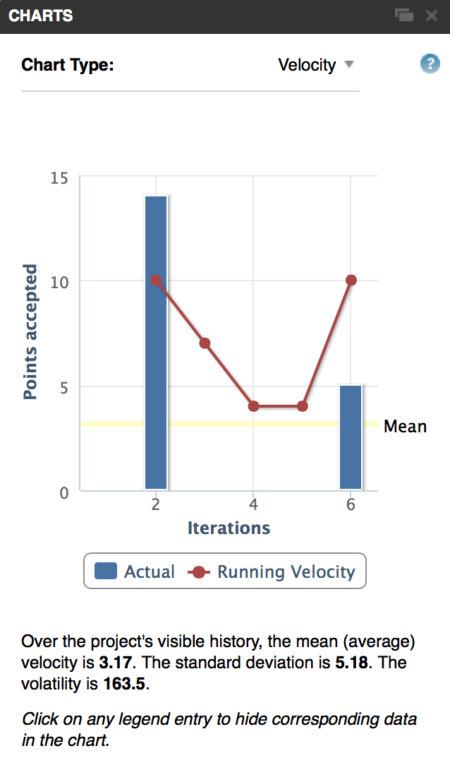
PIVOTALTRACKER

Slide 17
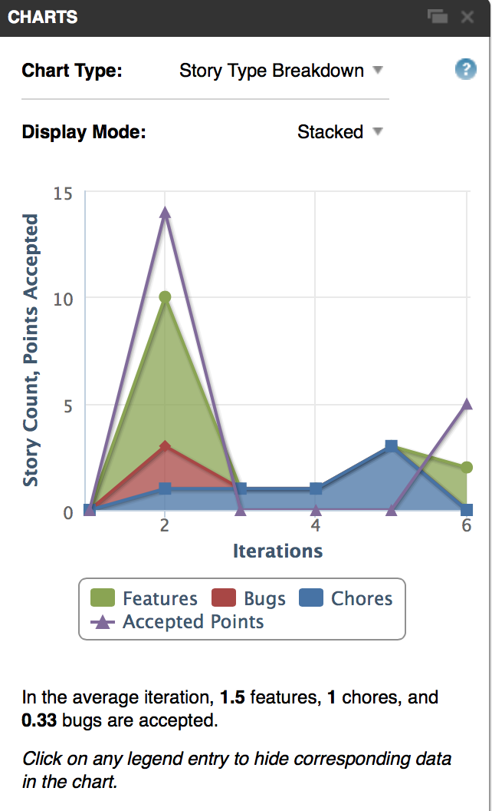
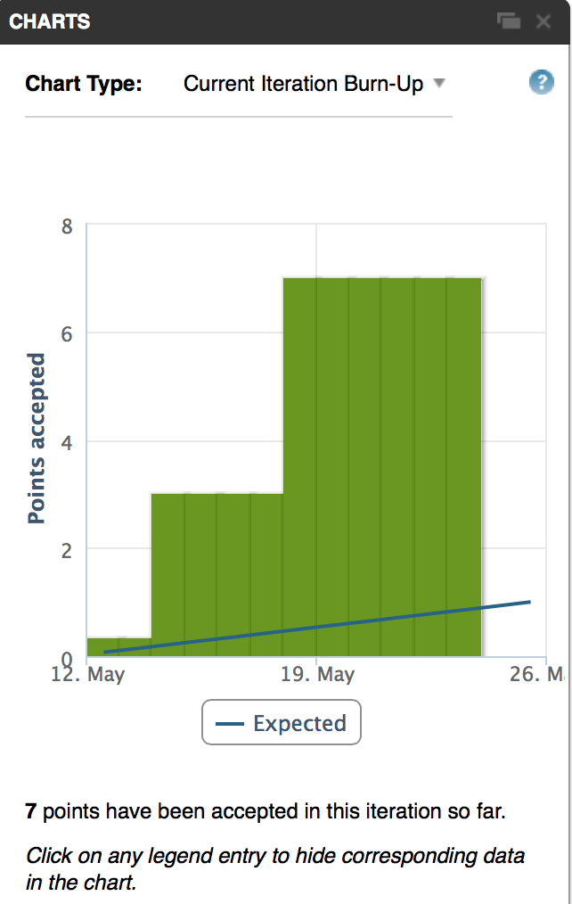
PIVOTALTRACKER

Slide 18
REVISION CONTROL AND SOURCE CODE MANAGEMENT
github.com/tranvictor/landlord

Slide 19
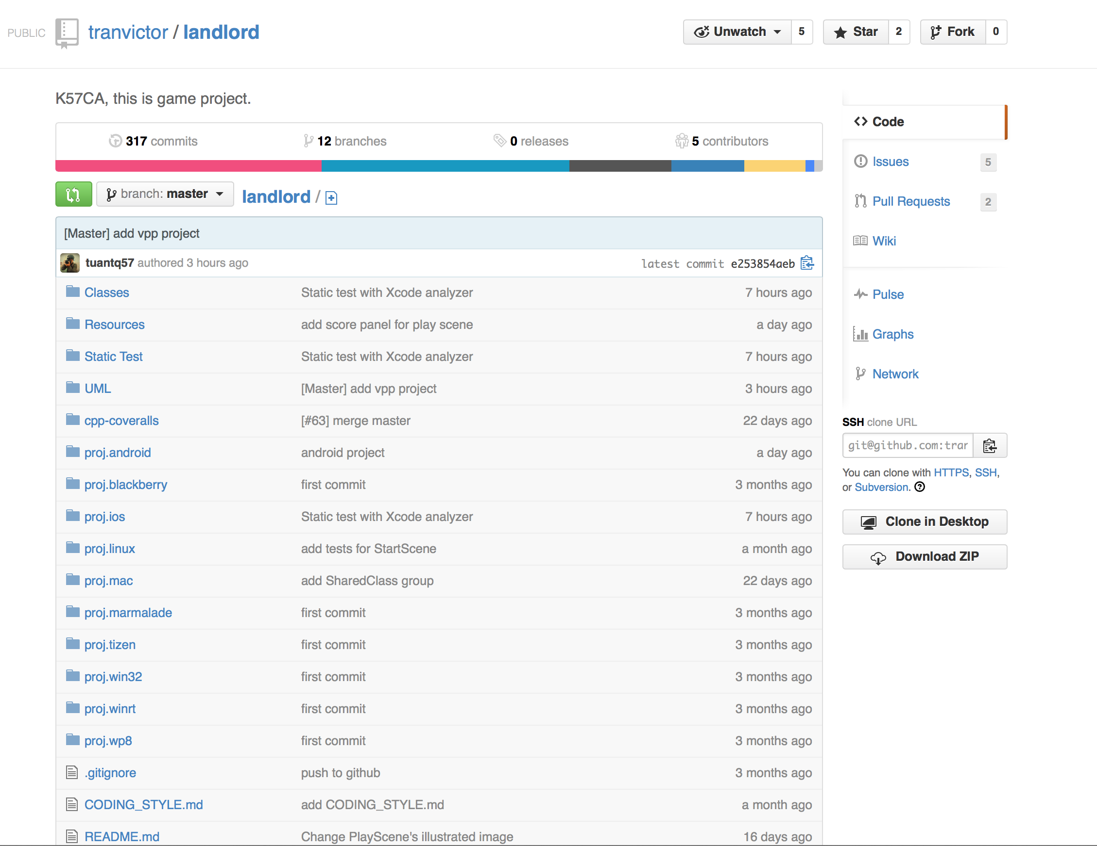
GITHUB REPO

Slide 20
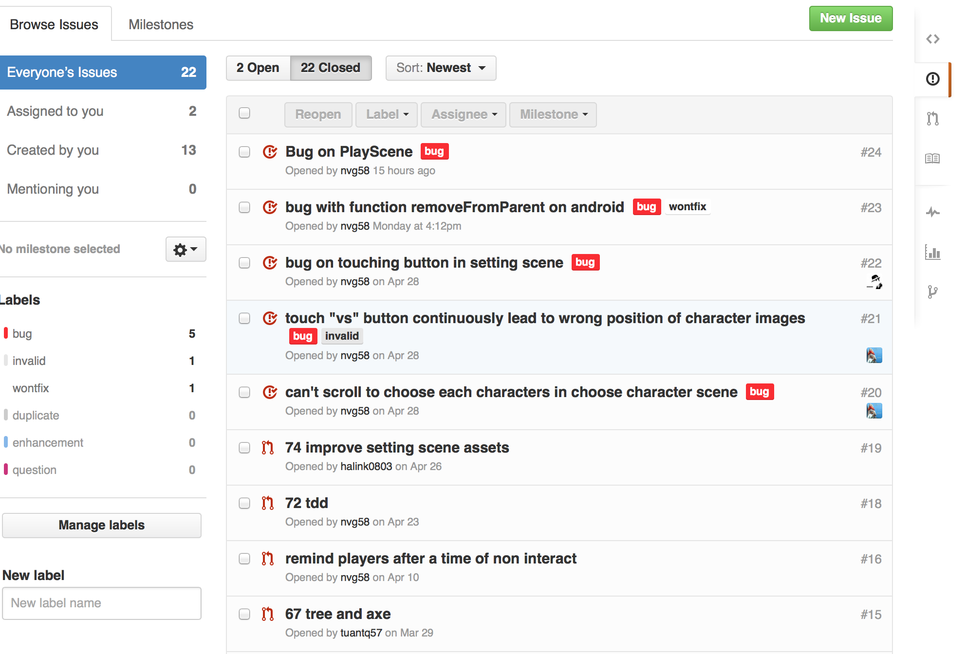
BUG TRACKING

Slide 21
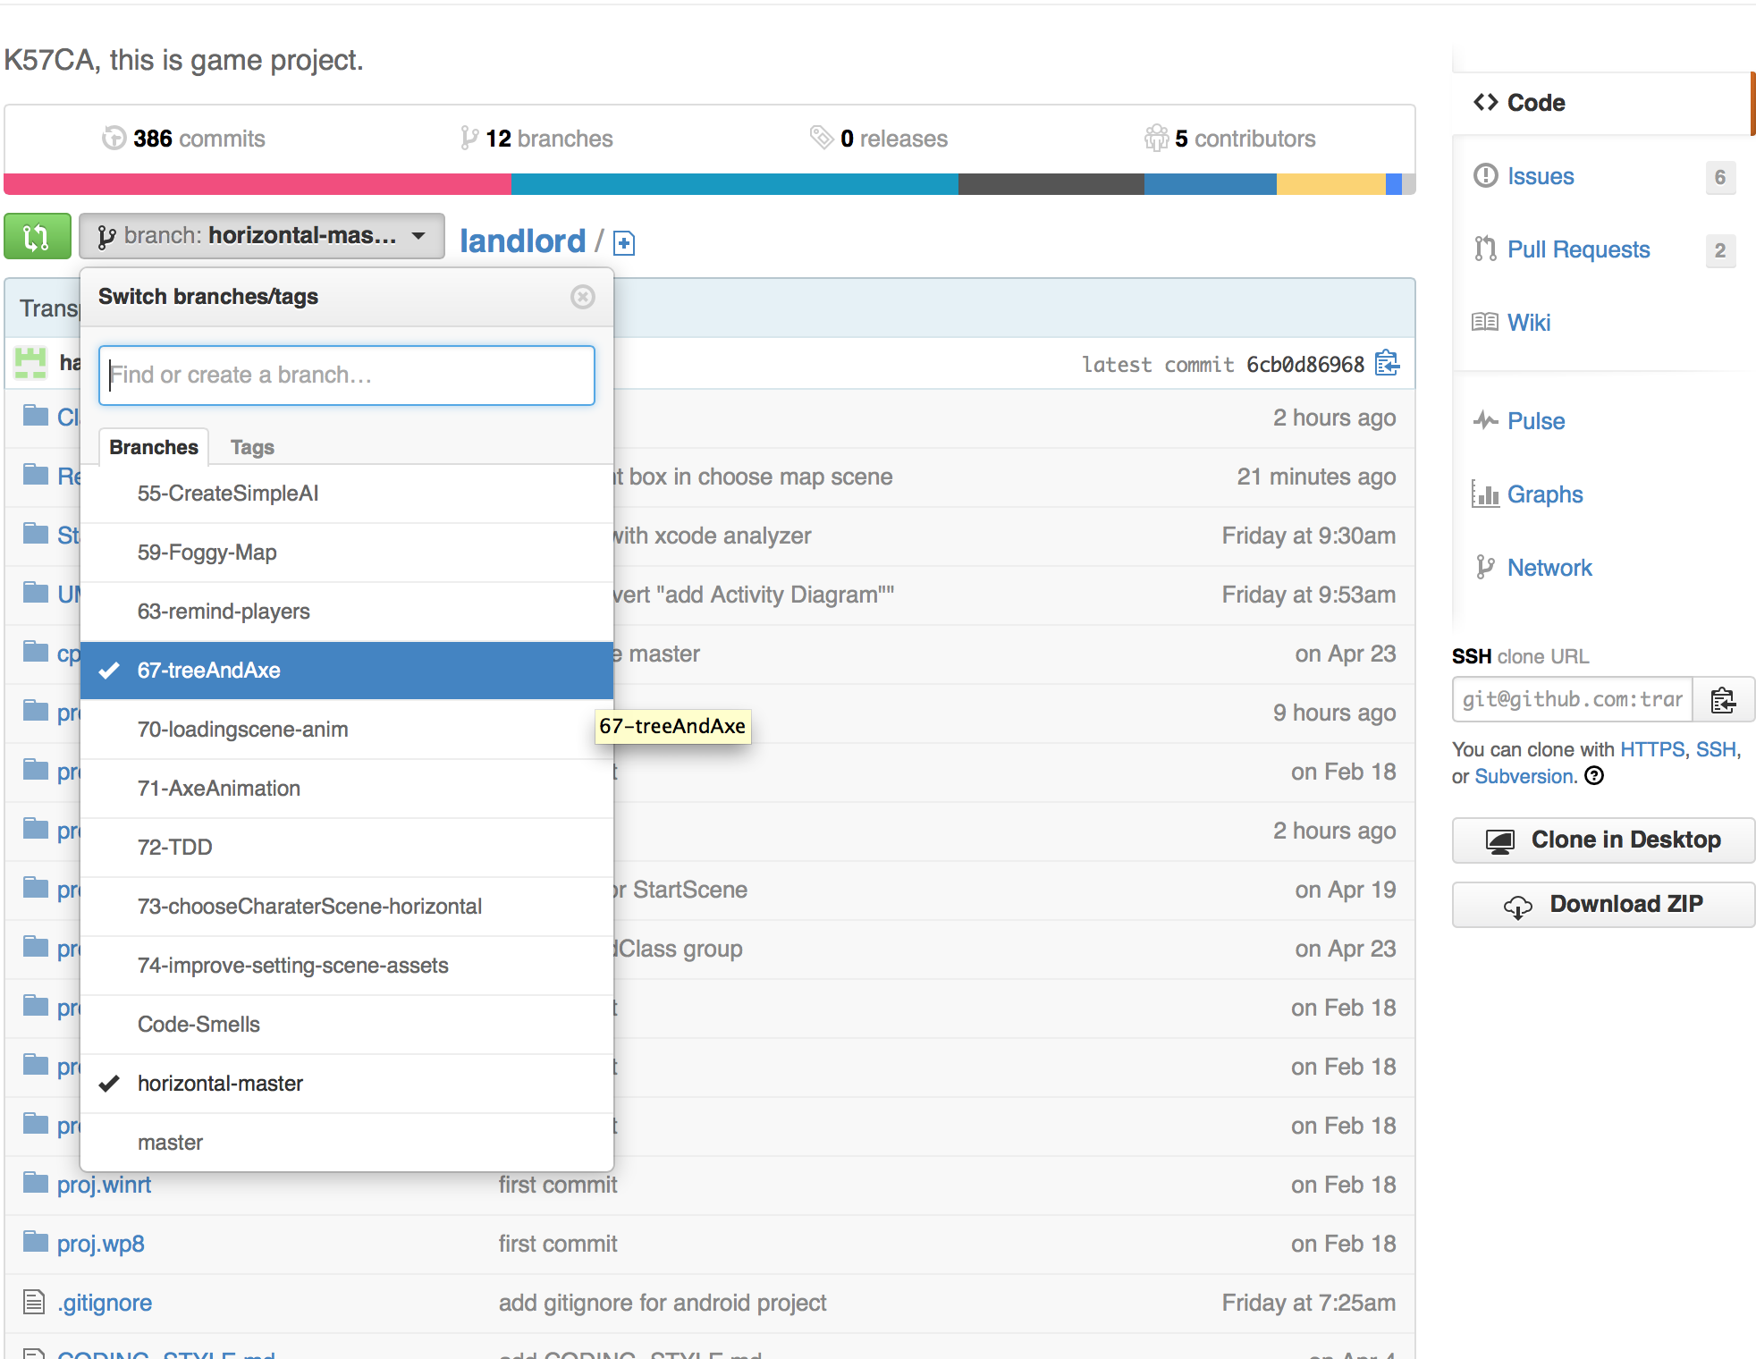
GIT WORKFLOW

Slide 22
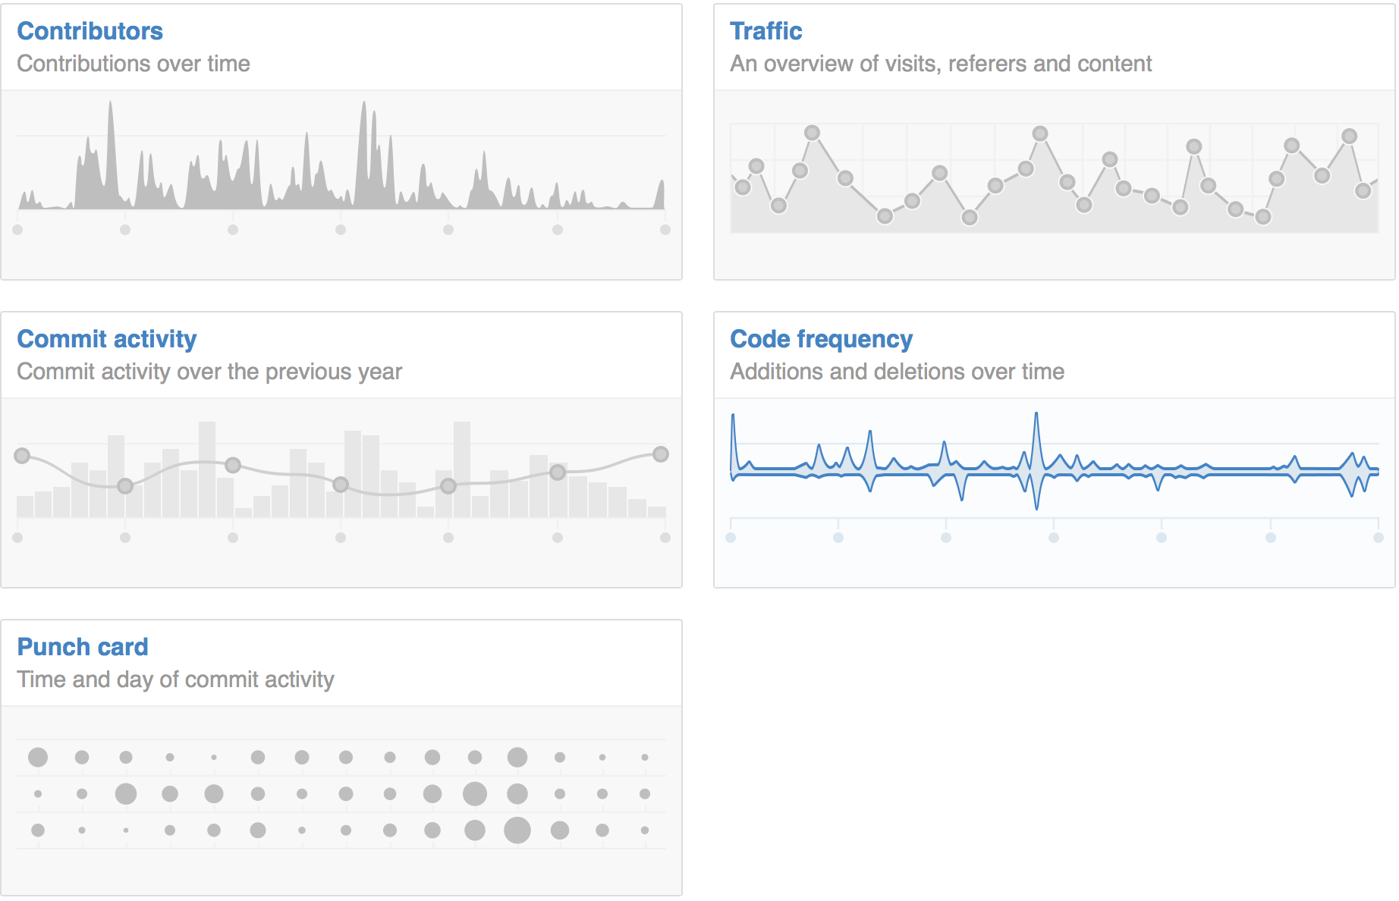
STATISTICS

Slide 23
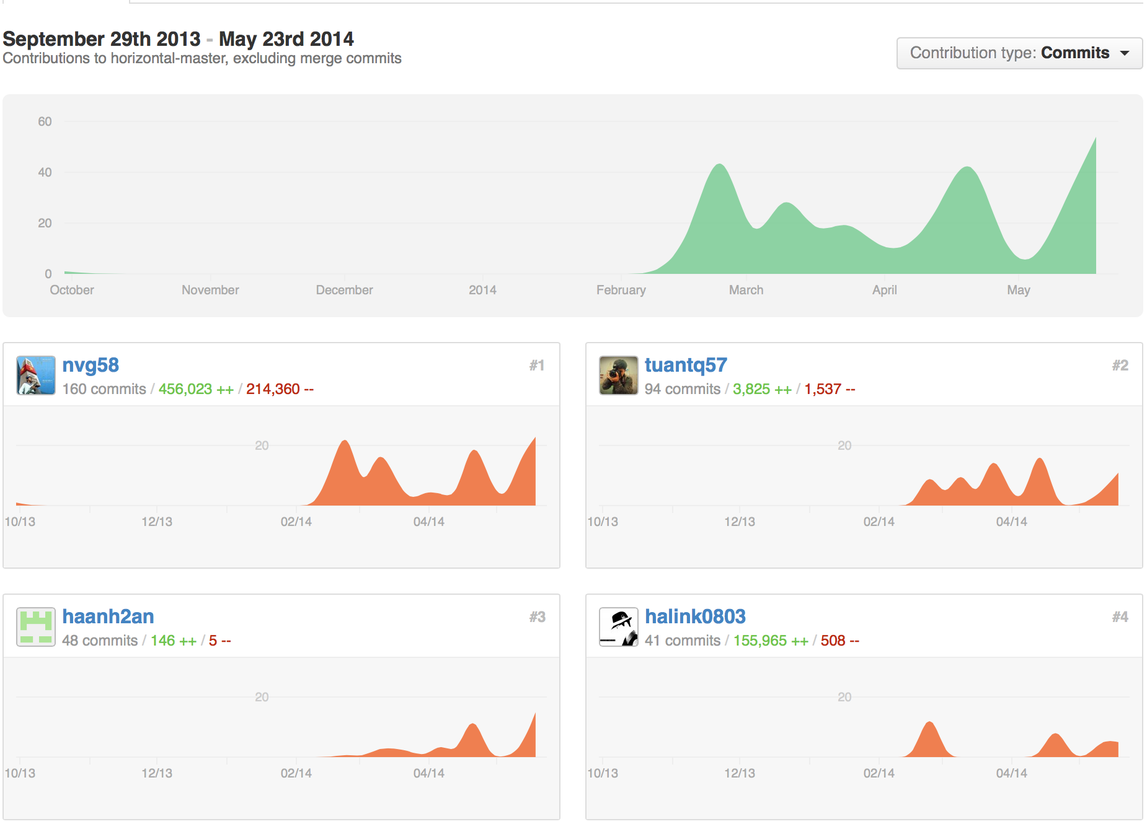
CONTRIBUTION

Slide 24
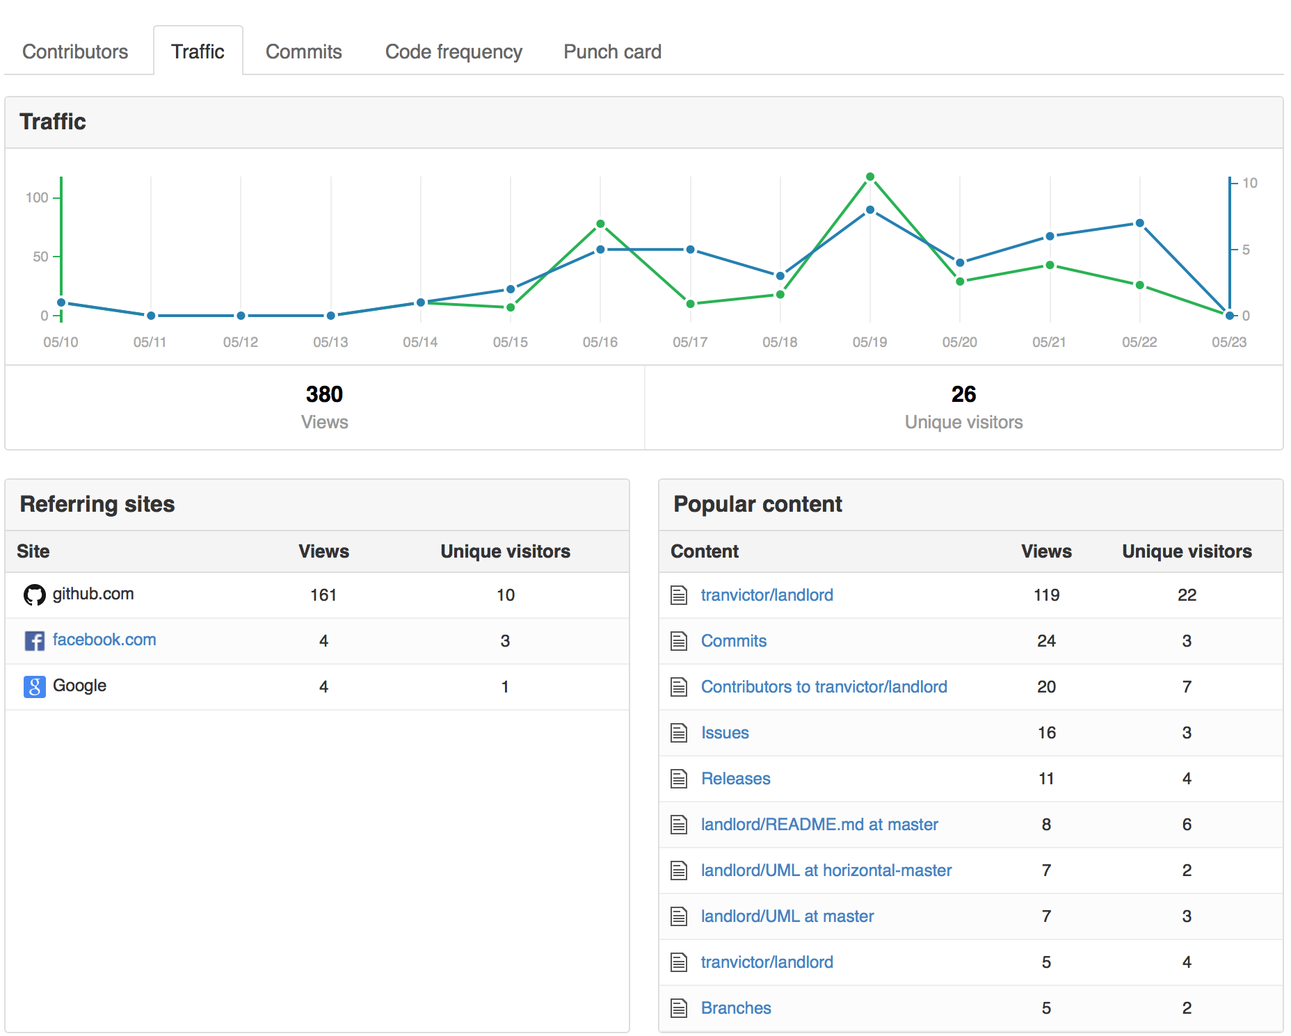
TRAFFIC

Slide 25
SOFTWARE DEVELOPMENT PROCESS
Using Test-driven development (TDD)

Slide 26
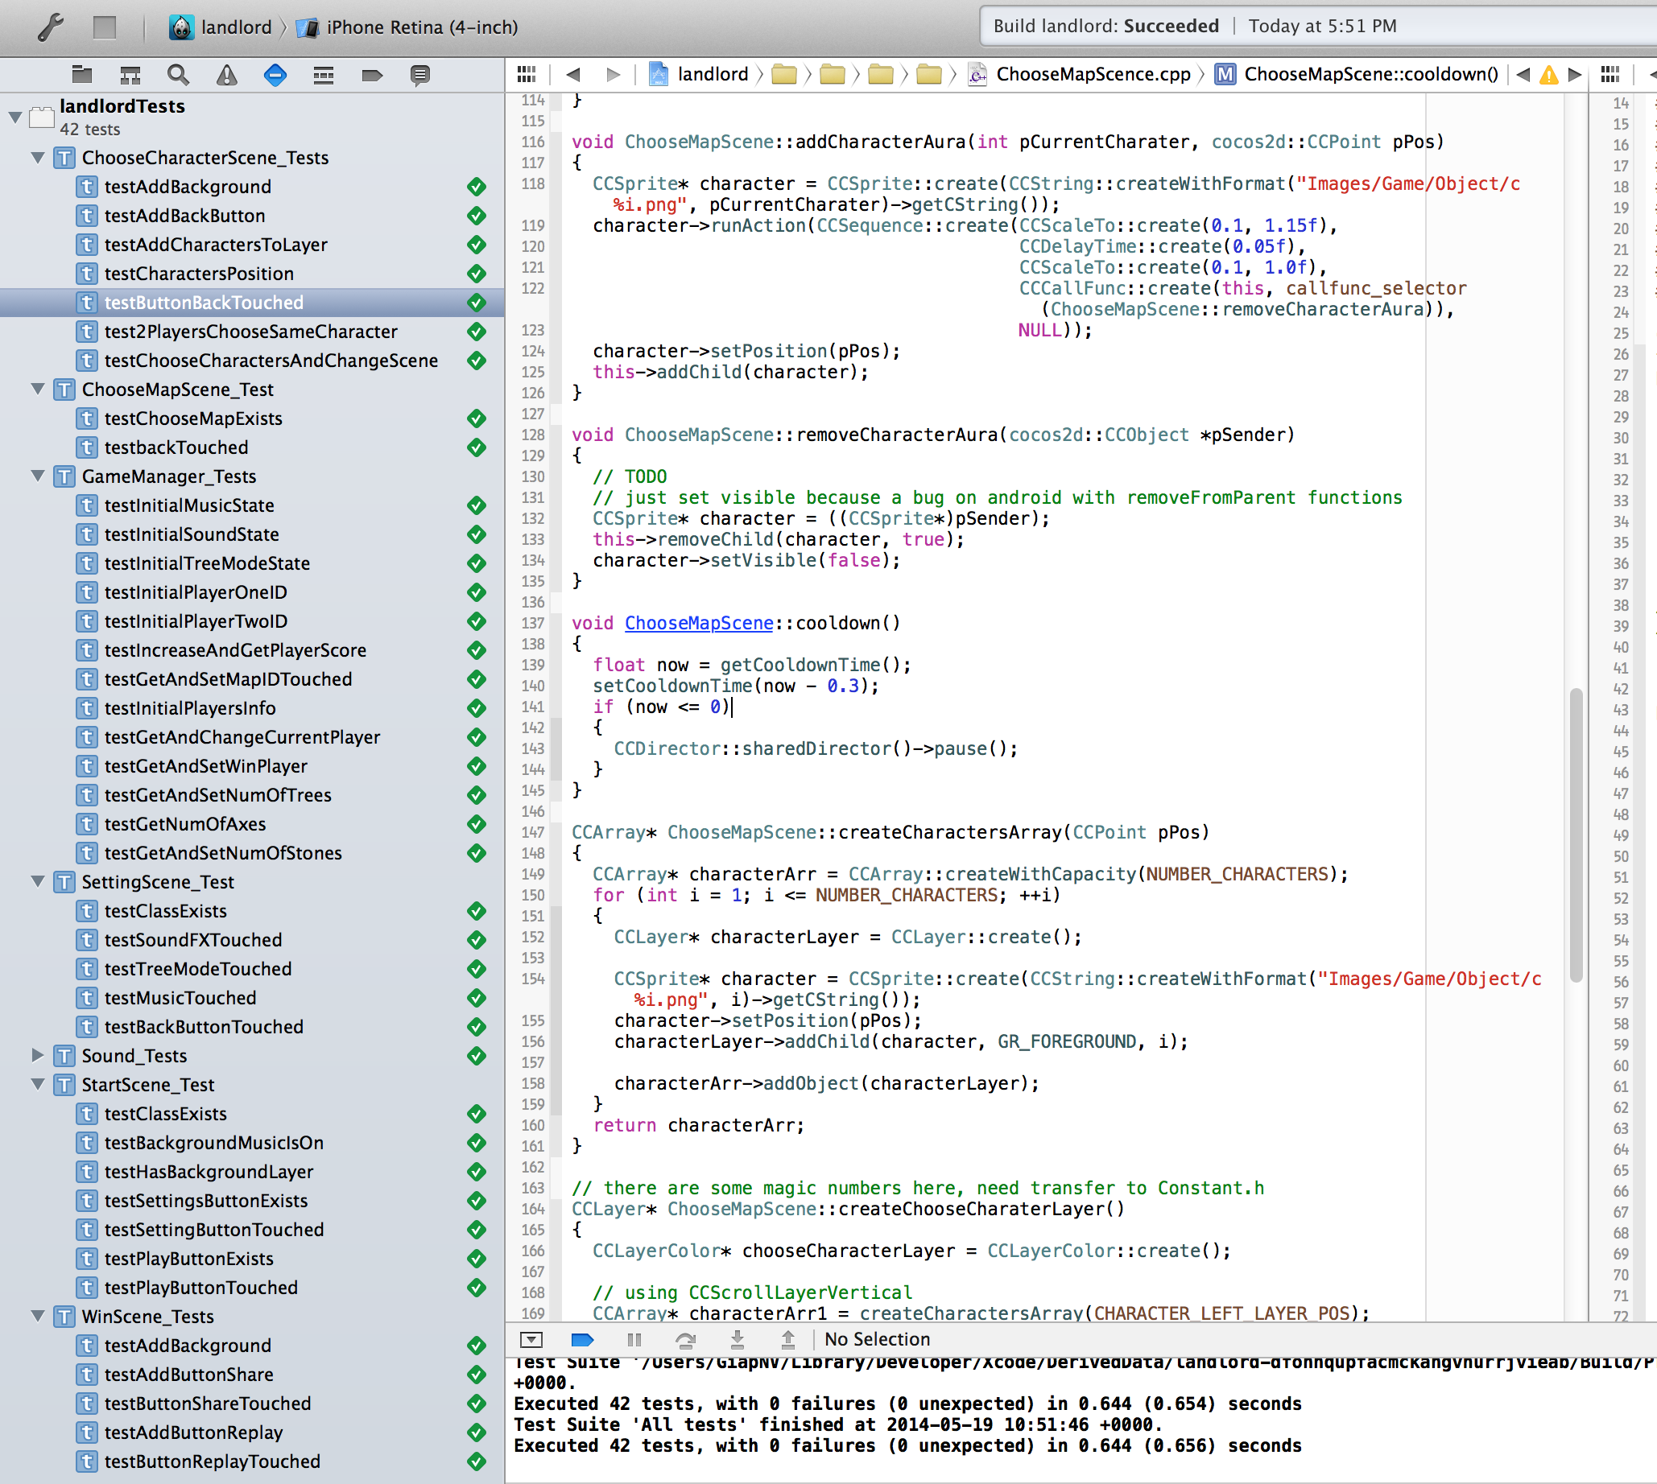
SENTESTINGKIT

Slide 27
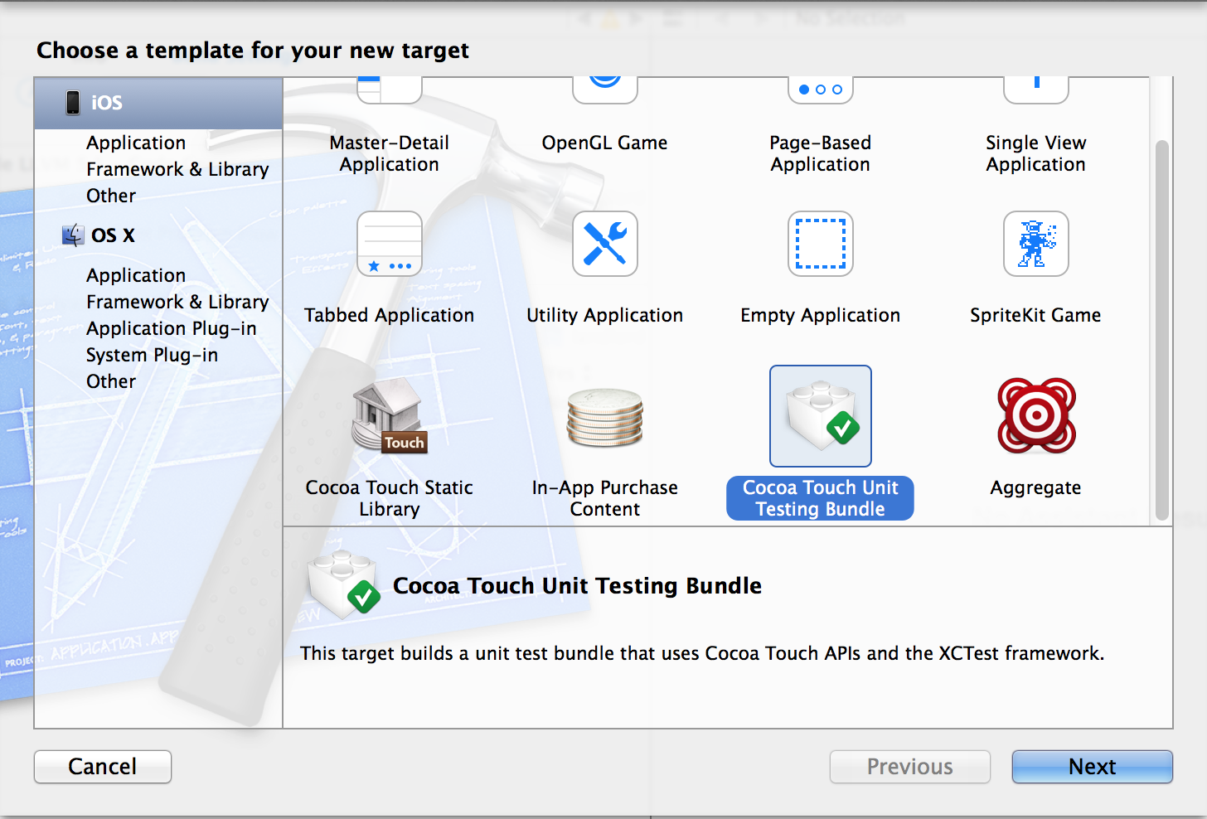
COCOA TOUCH UNIT TESTING

Slide 28
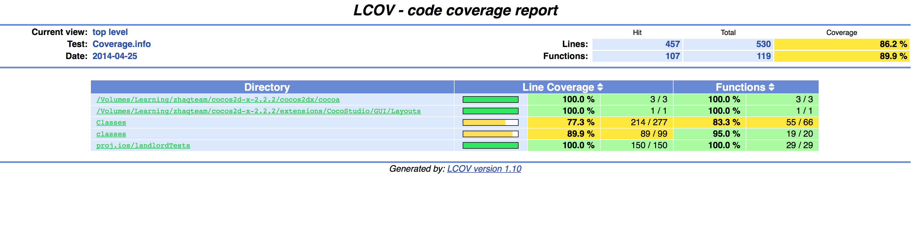
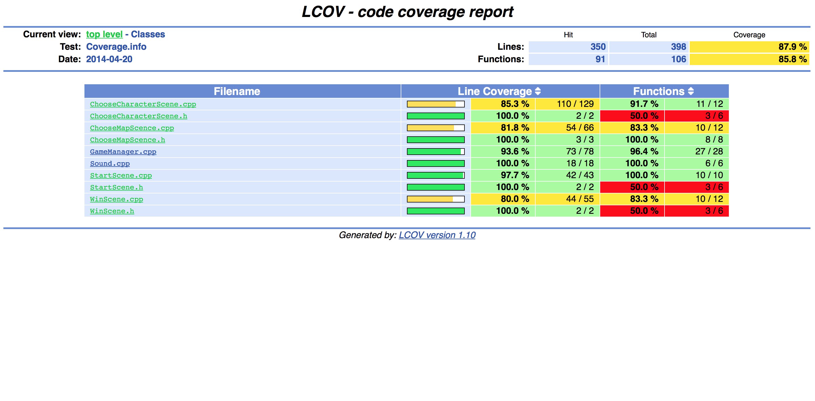
TEST COVERAGE

Slide 29
STATIC SOURCE CODE ANALYSIS
Using LLVM 3.4

Slide 30
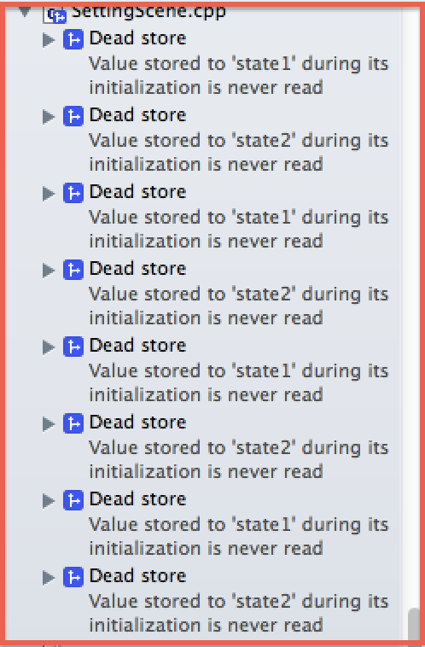
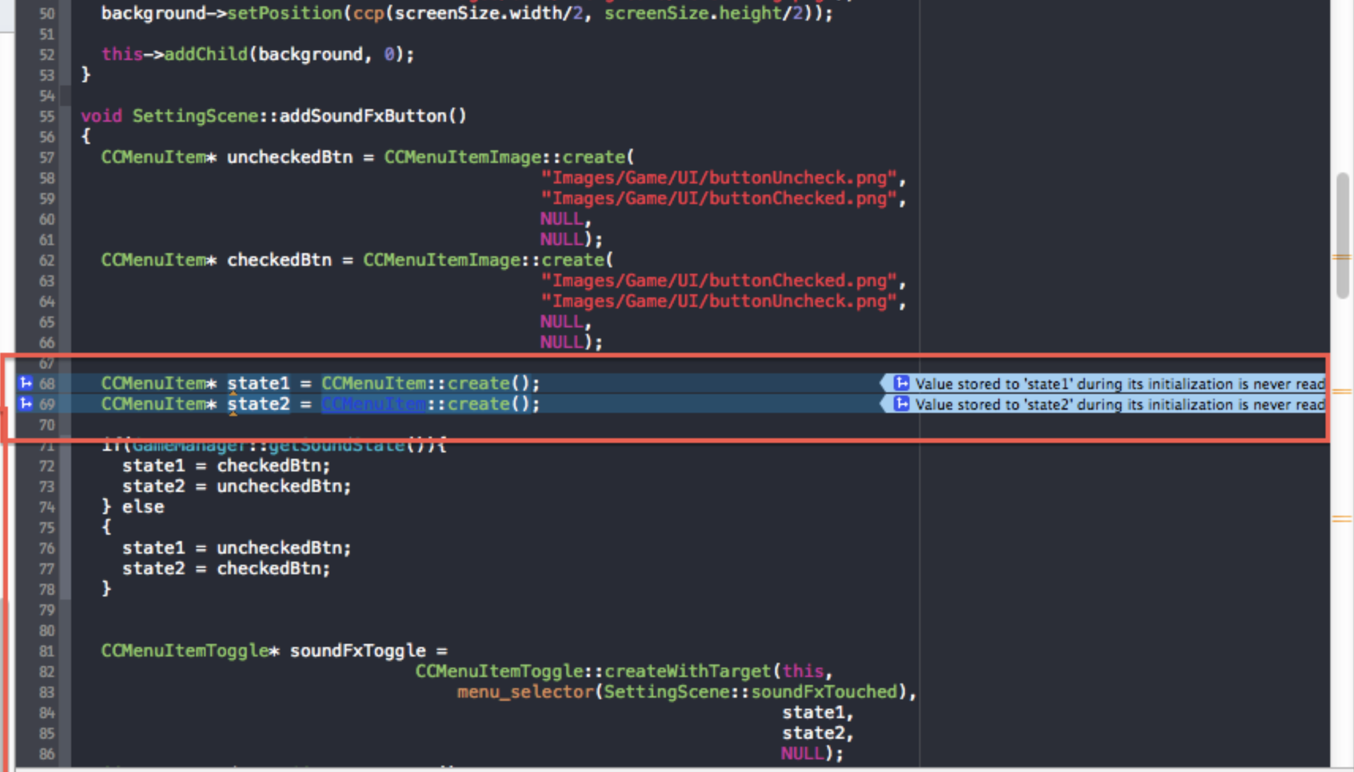
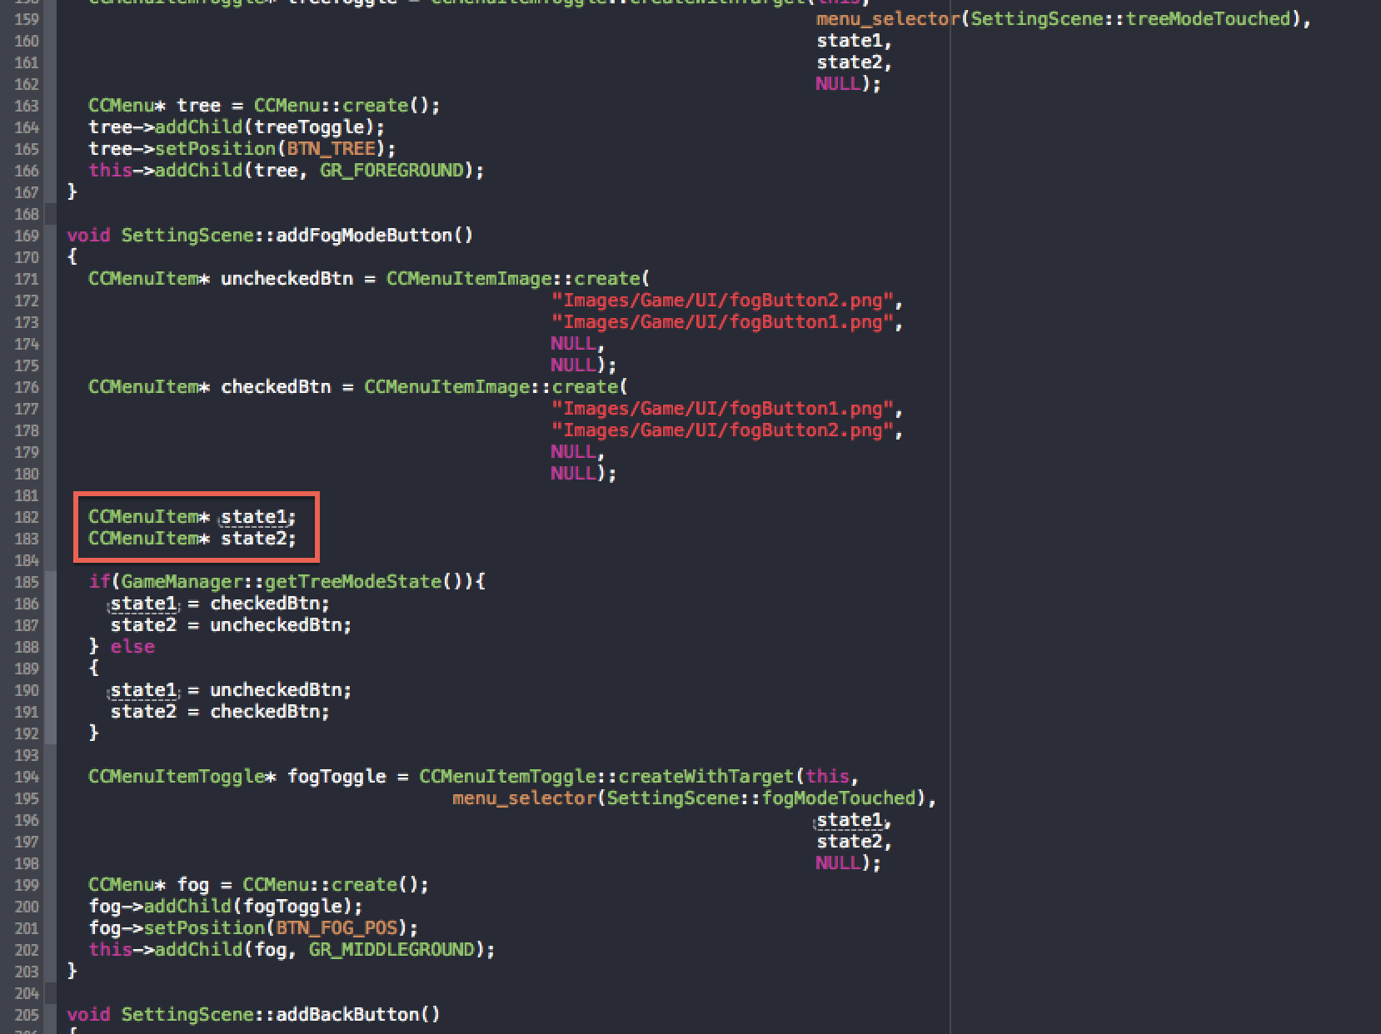
LLVM 3.4

Slide 31
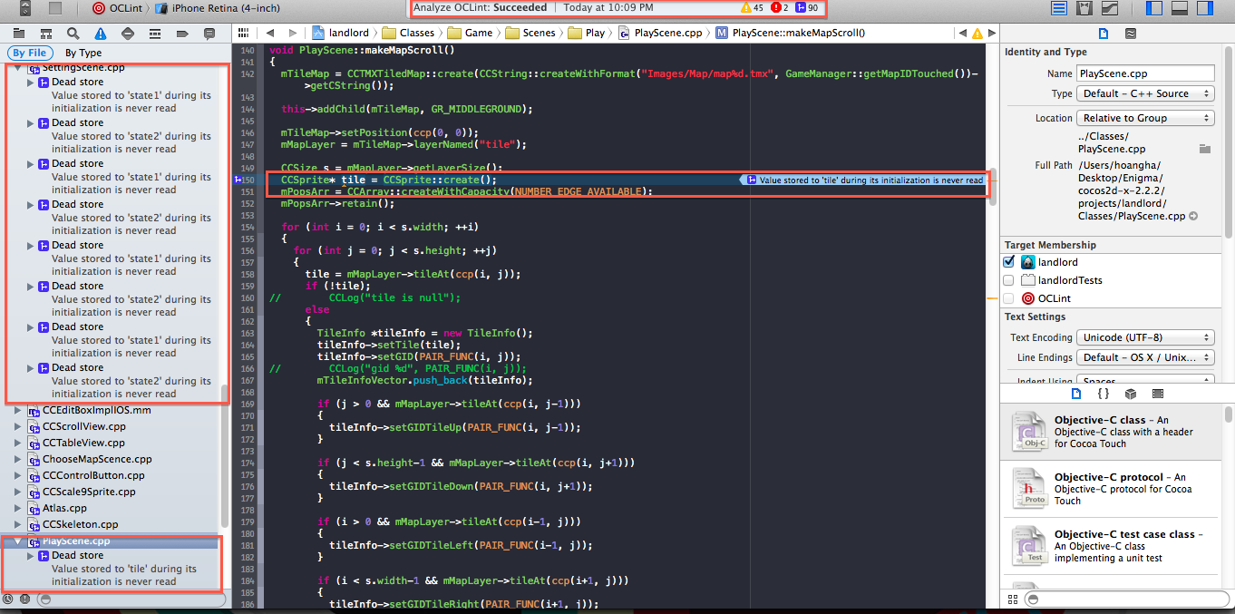
BEFORE

Slide 32
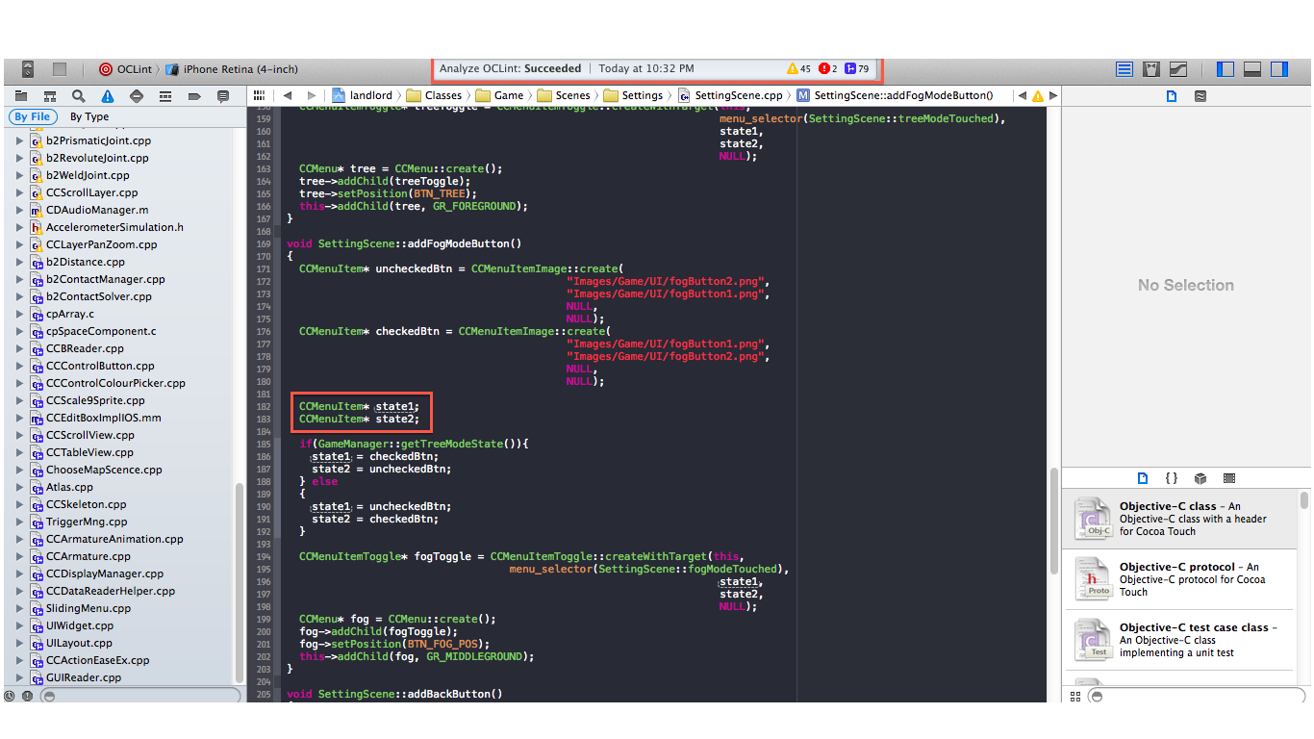
AFTER

Slide 33
SYSTEM'S ARCHITECTURAL BLUEPRINTS
Unified Modeling Language (UML)

Slide 34
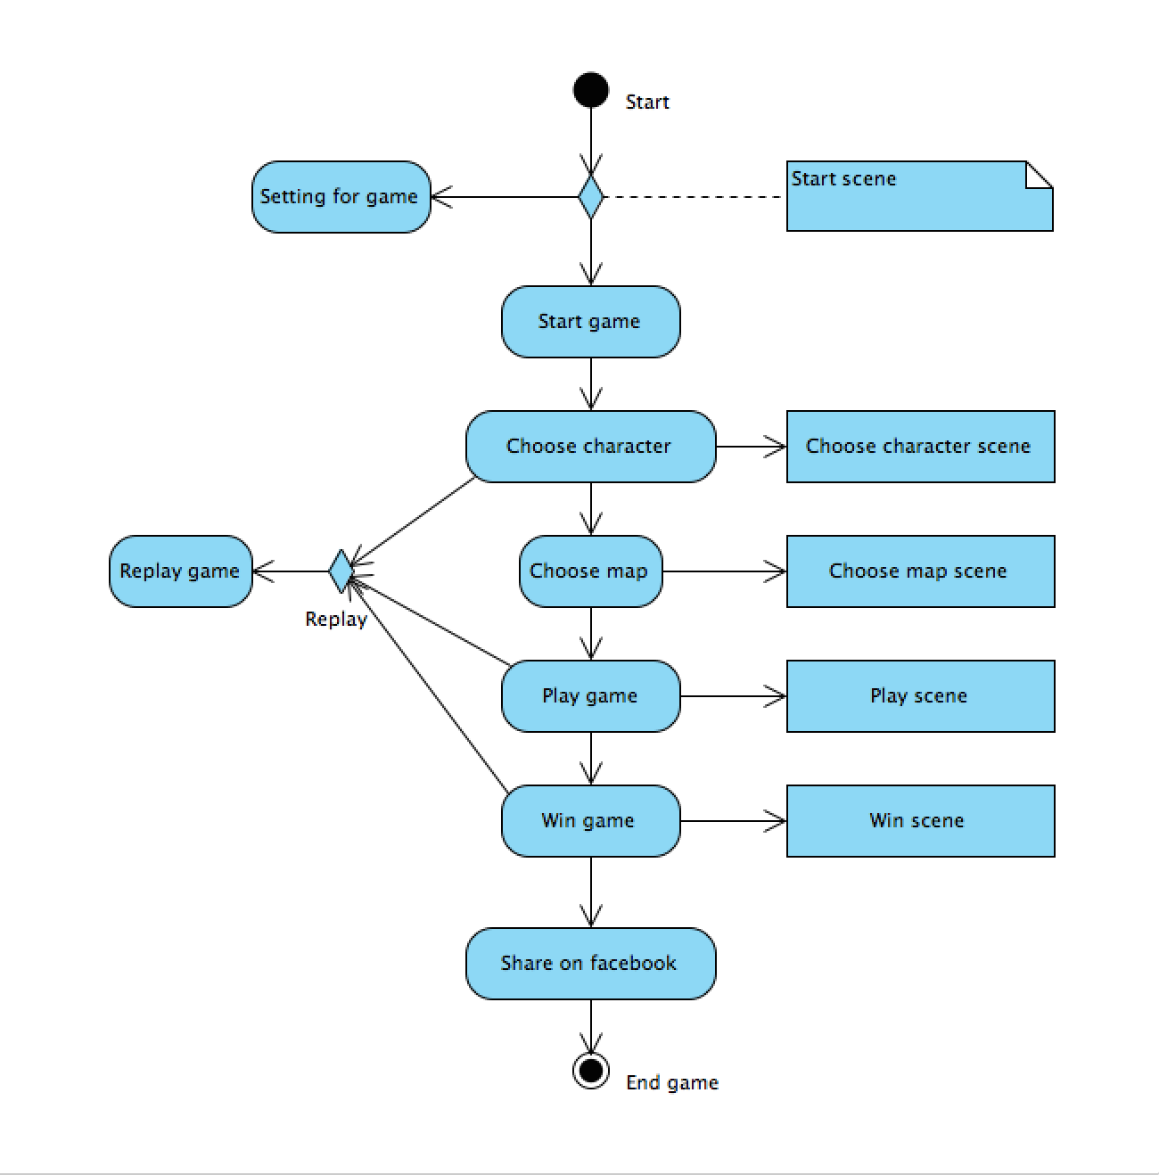
ACTIVITY DIAGRAM

Slide 35
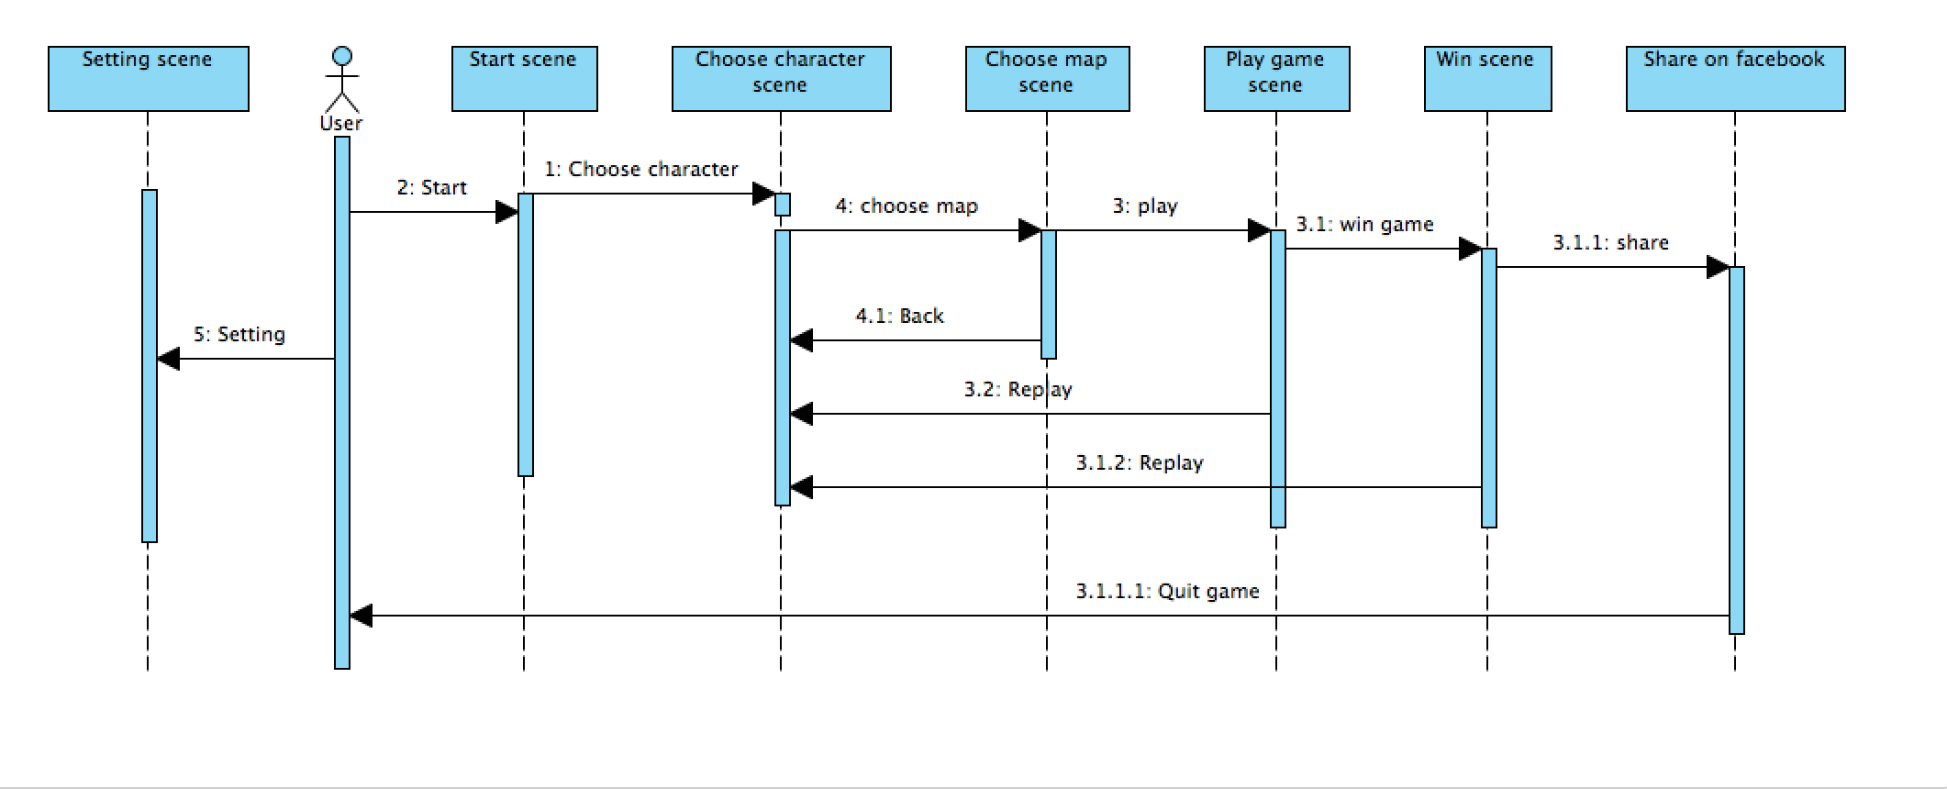
SEQUENCE DIAGRAM

Slide 36
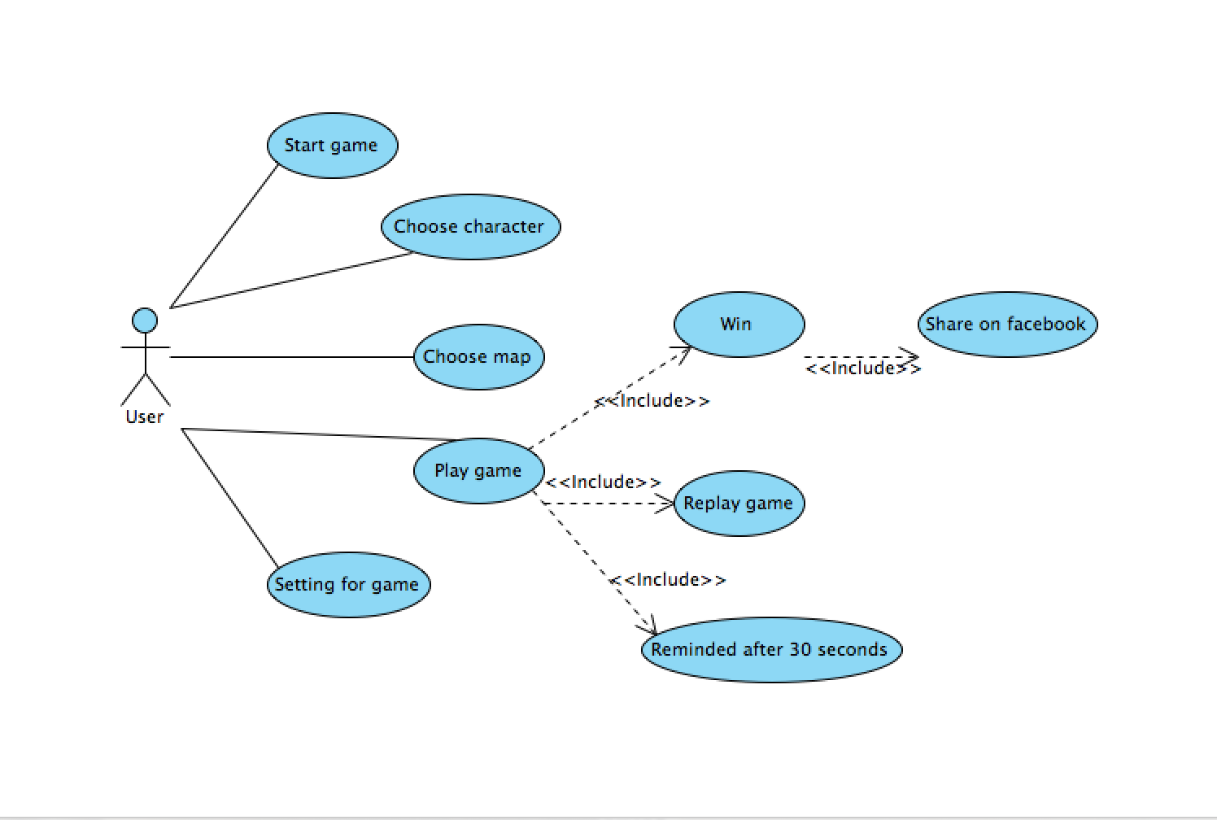
USE CASE DIAGRAM

Slide 37
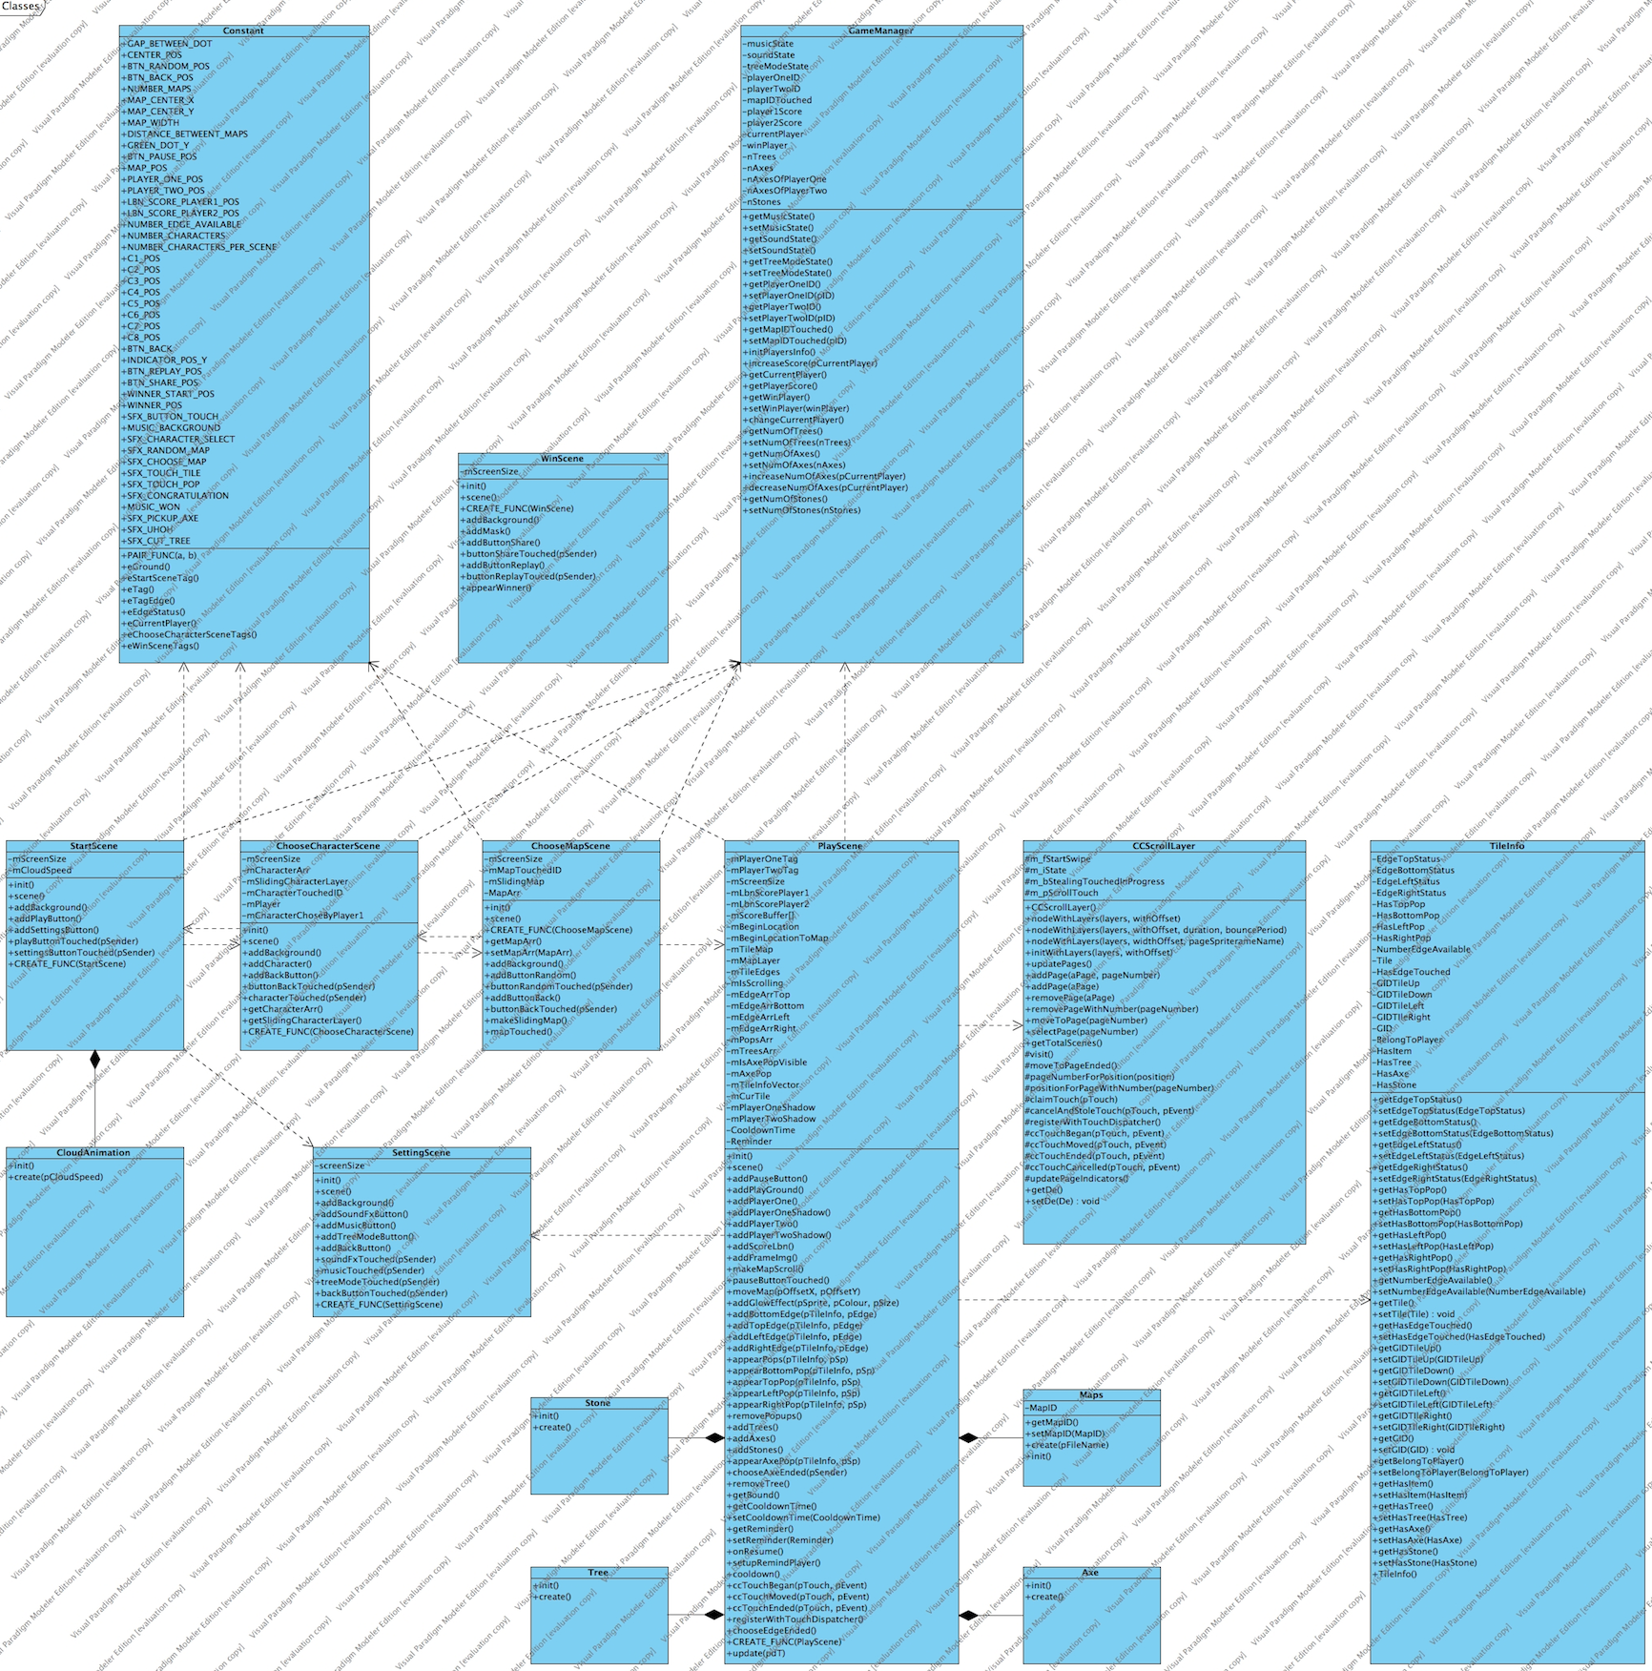
CLASS DIAGRAM

Slide 38
RELEASE
V0.1

Slide 39
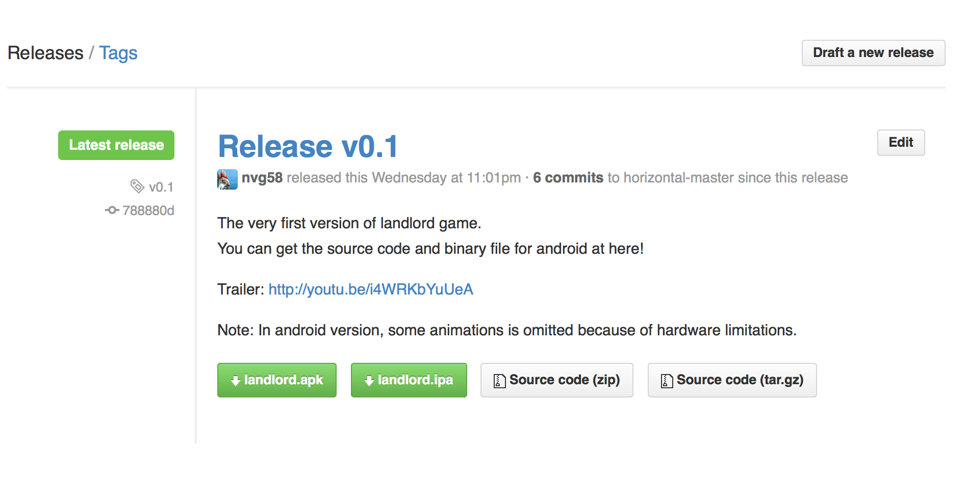
v0.1

Slide 40
THANK YOU FOR YOUR LISTENING!

